Slide 1

Encryption Decryption using Laplace Transform
By: Rishav Acharya

Slide 2

Table of Content
Introduction
Literature Review
Objective
Methodology
Conclusion

Slide 3
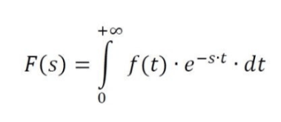
Introduction
Cryptography
Plain Text
Cipher Text
Laplace Transform

Slide 4
Literature Review
In paper [1], the author has proposed an iterative method using Laplace transform for encrypting the plain text and the inverse Laplace transform for the decryption. He used infinite series expansion of hyperbolic function and Laplace transforms for developing iterative technique for encryption and decryption.
In paper [2], the author has given an outline about the encryption and decryption process while message communication. Here the author has proposed to use the binary value of the ASCII code of plain text and using it as the base to encrypt and later to decrypt too.
In paper [3], the authors proposed to use the ASCII value of plain text and two distinct prime numbers which later is encrypted using Laplace transform of given formulae and decrypted using inverse Laplace transform.

Slide 5
Objective
To present a technique that can be used as cryptographic scheme during data transmission.

Slide 6
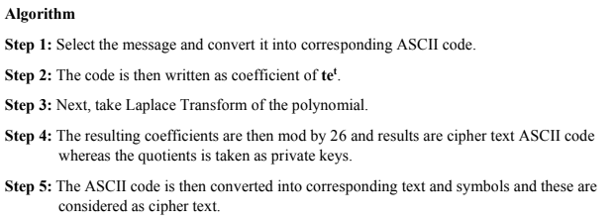
Methodology
Encryption

Slide 7
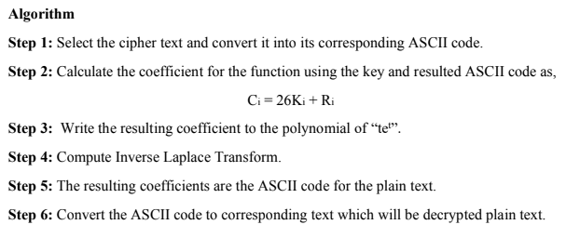
Methodology
Decryption

Slide 8
Conclusion
The method of key generation which is entirely based upon the sent message.
The key and decrypted text is solved using a modular arithmetic.
Every time when a new message or plain text is sent to the receiver, the cipher text will also be changed.

Slide 9

Thank You

